Slide 1
Logistics and Supply Chain Management
Chapter 1 & 2 Strategic Framework
Notes:
Introductions – Names, prior work experience including summer, what do students hope to get from class?
Mention some prototypical supply chains we will use repeatedly in class – Wal-Mart, 7-Eleven, Dell and Compaq, Amazon and Borders, Supermarket and e-grocer, W.W. Grainger and McMaster Carr - our goal is to identify factors that drive supply chain success and make a comparison between different supply chains.
Administration of course - We will discuss concepts and methodologies for supply chain management. The context within which both will be learnt and discussed is provided by cases. Discuss role of case packet readings, cases and book.
5 cases due - 10% for each case
25% for final project
20% for final exam
5% for electronic posting
Discuss key dates for submitting project. Three groups will be selected to present.
Show course web page and its organization

Slide 2
Logistics in the Manufacturing Firm
Profit 4%
Logistics Cost 21%
Marketing Cost 27%
Manufacturing Cost 48%
Profit
Logistics
Cost
Marketing
Cost
Manufacturing
Cost
Notes:
Notes: Key message here is that logistics costs are a significant fraction of the total value of a product. The problem here is that this a purely cost based view of the supply chain and drives a firm to simply reducing logistics costs. This is an incomplete picture.

Slide 3
What is a Supply Chain?
All stages involved, directly or indirectly, in fulfilling a customer request
Includes manufacturers, suppliers, transporters, warehouses, retailers, and customers
Within each company, the supply chain includes all functions involved in fulfilling a customer request (product development, marketing, operations, distribution, finance, customer service)
Examples: Detergent supply chain (Wal-Mart), Dell
Notes:
“functions” of a company are customer driven, as a result

Slide 4
What is a Supply Chain?
P&G or other
manufacturer
Jewel or third
party DC
Jewel
Supermarket
Customer wants
detergent and goes
to Jewel
Plastic
Producer
Tenneco
Packaging
Chemical
manufacturer
(e.g. Oil Company)
Chemical
manufacturer
(e.g. Oil Company)
Paper
Manufacturer
Timber
Industry
Information
Supply Chain
Product
Customer
Funds
Notes:
Notes:
Supply chain involves everybody, from the customer all the way to the last supplier.
Key flows in the supply chain are - information, product, and cash. It is through these flows that a supply chain fills a customer order. The management of these flows is key to the success or failure of a firm. Give Dell & Compaq example, Amazon & Borders example to bring out the fact that all supply chain interaction is through these flows.
Customer is an integral part of the supply chain
Includes movement of products from suppliers to manufacturers to distributors, but also includes movement of information, funds, and products in both directions
Probably more accurate to use the term “supply network” or “supply web”
Typical supply chain stages: customers, retailers, distributors, manufacturers, suppliers
All stages may not be present in all supply chains (e.g., no retailer or distributor for Dell)

Slide 5
The Objective of a Supply Chain
Maximize overall value created
Supply chain value: difference between what the final product is worth to the customer and the effort the supply chain expends in filling the customer’s request
Value is correlated to supply chain profitability (difference between revenue generated from the customer and the overall cost across the supply chain)
Supply chain profitability is total profit to be shared across all stages of the supply chain

Slide 6
Three Decision Phases in a Supply Chain
Supply Chain Strategy and Design (Years)
Supply chain design must support strategic objectives
Network Design : Decisions about the structure of the supply chain and what processes each stage will perform
Supply Chain Planning (Quarter to a Year)
Definition of a set of policies that govern short-term operations
Demand and Supply Planning
Inventory Planning
Supply Chain Operation (Daily to Weekly)
Manufacturing
Distribution

Slide 7
Supply Chain Strategy or Design
Strategic supply chain decisions
Locations and capacities of facilities
Products to be made or stored at various locations
Modes of transportation
Information systems
Supply chain design decisions are long-term and expensive to reverse
– must take into account market uncertainty

Slide 8
Supply Chain Planning
Fixed by the supply configuration from previous phase
Starts with a forecast of demand in the coming year
Planning decisions:
Which markets will be supplied from which locations
Planned buildup of inventories
Subcontracting, backup locations
Inventory policies
Timing and size of market promotions
Must consider in planning decisions demand uncertainty, exchange rates, competition over the time horizon

Slide 9
Supply Chain Operation
Time horizon is weekly or daily
Decisions regarding individual customer orders
Goal is to implement the operating policies as effectively as possible
Decisions:
allocate orders to inventory or production
set order due dates
generate pick lists at a warehouse
allocate an order to a particular shipment
set delivery schedules
place replenishment orders
Much less uncertainty (short time horizon)

Slide 10
Process View of a Supply Chain
Cycle view: processes in a supply chain are divided into a series of cycles, each performed at the interfaces between two successive supply chain stages
Push/pull view: processes in a supply chain are divided into two categories depending on whether they are executed
in response to a customer order (pull) or
in anticipation of a customer order (push)

Slide 11
Cycle View of Supply Chains
Each cycle occurs at the interface between two successive stages
Cycle view clearly defines processes involved and the owners of each process.
Specifies the roles and responsibilities of each member and the desired outcome of each process.
Customer
Customer Order Cycle
Retailer
Replenishment Cycle
Distributor
Manufacturing Cycle
Manufacturer
Procurement Cycle
Supplier
Notes:
The supply chain is a concatenation of cycles with each cycle at the interface of two successive stages in the supply chain. Each cycle involves the customer stage placing an order and receiving it after it has been supplied by the supplier stage.
One difference is in size of order. Second difference is in predictability of orders - orders in the procurement cycle are predictable once manufacturing planning has been done.
This is the predominant view for ERP systems. It is a transaction level view and clearly defines each process and its owner.

Slide 12
Cycle View of Supply Chain
Customer Order Cycle
Customer arrival, order entry, order fulfillment, and customer order receiving
Replenishment Cycle
Retail order trigger & order entry, retail order fulfillment, retail order receiving
Manufacturing Cycle
Order arrival, production scheduling, manufacturing and shipping, receive at destination
Procurement Cycle
All processes ensuring manufacturing materials available when needed to produce on schedule
Important that suppliers be linked to the manufacturer’s production schedule

Slide 13
Push/Pull View of Supply Chains
Procurement,
Customer Order
Manufacturing and
Cycle
Replenishment cycles
PUSH PROCESSES
PULL PROCESSES
Customer
Order Arrives
Pull: execution is initiated in response to a customer order (reactive)
Push: execution is initiated in anticipation of customer orders (speculative)
Notes:
In this view processes are divided based on their timing relative to the timing of a customer order. Define push and pull processes.
They key difference is the uncertainty during the two phases.
Give examples at Amazon and Borders to illustrate the two views

Slide 14
What is the SCOR model?
It stands for Supply Chain Operations Reference model
It’s a process reference model developed and endorsed by the Supply-Chain Council
It’s based on 5 management processes
Plan
Plan
Source
Source
Make
Make
Deliver
Deliver
Return
Return

Slide 15
Scopes of Basic Management Processes
Plan (Processes that balance aggregate demand and supply to develop a course of action which best meets sourcing, production and delivery requirements)
Balance resources with requirements
Establish/communicate plans for the whole supply chain
Source (Processes that procure goods and services to meet planned or
actual demand)
Schedule deliveries (receive, verify, transfer)
Make (Processes that transform product to a finished state to meet planned or actual demand)
Schedule production
Deliver (Processes that provide finished goods and services to meet planned or actual demand, typically including order management, transportation management, and distribution management)
Warehouse management from receiving and picking product to load and ship product.
Return (Processes associated with returning or receiving returned products)
Manage Return business rules

Slide 16
Supply Chain Operations Reference Model (SCOR)
Integrates Business Process Reengineering, Benchmarking, and Process Measurement into a cross-functional framework.
Capture the “as-is” state of a process and derive the desired “to-be” future state
Quantify the operational performance of similar companies and establish internal targets based on “best-in-class” results
Characterize the management practices and software solutions that result in “best-in-class” performance
Capture the “as-is” state of a process and derive the desired “to-be” future state
Quantify the operational performance of similar companies and establish internal targets based on “best-in-class” results
Characterize the management practices and software solutions that result in “best-in-class” performance
Business Process Reengineering
Benchmarking
Best Practices Analysis
Process Reference Model

Slide 17
Supply Chain Operations Reference Model (SCOR): Boundaries
SCOR spans:
All customer interactions, from order entry through paid invoice.
All product (physical material and service) transactions, from supplier’s supplier to customer’s customer, including equipment, supplies, spare parts, bulk product, software, etc.
All market interactions, from the understanding of aggregate demand to the fulfillment of each order
SCOR does not describe :
Sales and marketing (demand generation)
Research and technology development
Product development
Some elements of post-delivery customer support

Slide 18
Supply Chain Operations Reference Model (SCOR): Basic Management Processes
Plan-Source-Make-Deliver-Return
Plan
Deliver
Source
Make
Deliver
Source
Make
Deliver
Source
Make
Deliver
Source
Supplier’s Supplier
Return
Return
Return
Return
Return
Return
Customer’s Customer
Supplier (Internal or External)
Customer (Internal or External)
Your Company
Plan-Source-Make-Deliver-Return provide the organizational structure of the SCOR-model

Slide 19
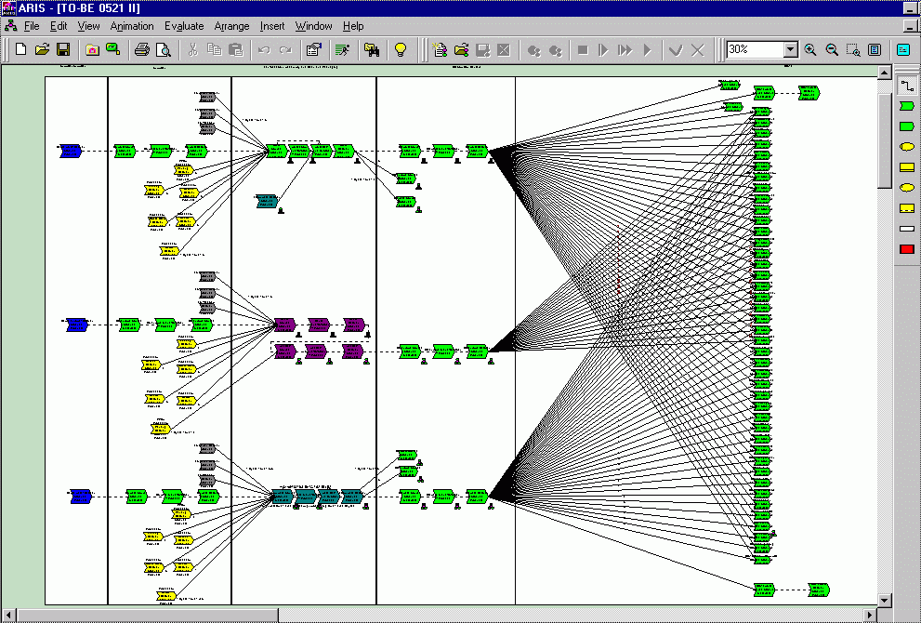
Process Map Example created in ARIS EasySCOR
Suppliers Supplier
Suppliers
Assemble/ Package
Distribution Centers
Geo Ports of Entry
Americas--->
Europe--->
Asia--->

Slide 20
Strategies
Competitive strategy: defines the set of customer needs a firm seeks to satisfy through its products and services
Product development strategy: specifies the portfolio of new products that the company will try to develop
Marketing and sales strategy: specifies how the market will be segmented and product positioned, priced, and promoted
Supply chain strategy:
determines the nature of material procurement, transportation of materials, manufacture of product or creation of service, distribution of product
Consistency and support between supply chain strategy, competitive strategy, and other functional strategies is important
The value chain determines the relationship between a company’s competitive strategy and its supply chain strategy

Slide 21
The Value Chain: Linking Supply Chain and Business Strategy
Business Strategy
New Product
Strategy
Marketing
Strategy
Supply Chain Strategy
New
Product
Development
Marketing
and
Sales
Operations
Distribution
Service
Finance, Accounting, Information Technology, Human Resources

Slide 22
Step 1: Understanding the Customer and Supply Chain Uncertainty
Demand uncertainty: uncertainty of customer demand for a product
Implied demand uncertainty: resulting uncertainty for the supply chain given the portion of the demand the supply chain must handle and attributes of customer desires
Implied demand uncertainty also related to customer needs and product attributes
First step to strategic fit is to understand customers by mapping their demand on the implied uncertainty spectrum

Slide 23
Impact of Customer Needs on Implied Demand Uncertainty
Customer Need | Causes implied demand uncertainty to increase because …
Range of quantity increases | Wider range of quantity implies greater variance in demand
Lead time decreases | Less time to react to orders
Variety of products required increases | Demand per product becomes more disaggregated
Number of channels increases | Total customer demand is now disaggregated over more channels
Rate of innovation increases | New products tend to have more uncertain demand
Required service level increases | Firm now has to handle unusual surges in demand

Slide 24
Levels of Implied Demand Uncertainty
Detergent
Long lead time steel
Purely functional products
High Fashion
Palm Pilot
Entirely new products
Customer Need
Price
Responsiveness
Low
High
Implied Demand Uncertainty

Slide 25
Step 2: Understanding the Supply Chain
How does the firm best meet demand?
Supply chain responsiveness -- ability to
respond to wide ranges of quantities demanded
meet short lead times
handle a large variety of products
build highly innovative products
meet a very high service level
Supply chain efficiency: cost of making and delivering the product to the customer
Increasing responsiveness results in higher costs that lower efficiency
Responsiveness
High
Low
Cost
High
Low

Slide 26
Achieving Strategic Fit Shown on the Uncertainty/Responsiveness Map
Responsive supply chain
Responsiveness spectrum
Zone of Strategic Fit
Efficient supply chain
Certain demand
Implied uncertainty spectrum
Uncertain demand
Highly
efficient
Somewhat
efficient
Somewhat
responsive
Highly
responsive
Integrated
steel mill
Hanes
apparel
Most
automotive
production
Dell

Slide 27
Step 3: Achieving Strategic Fit
Step is to ensure that what the supply chain does well is consistent with target customer’s needs
All functions in the value chain must support the competitive strategy to achieve strategic fit
Two extremes: Efficient supply chains (Barilla) and responsive supply chains (Dell)
Two key points
there is no right supply chain strategy independent of competitive strategy
there is a right supply chain strategy for a given competitive strategy
pasta
computers

Slide 28
Comparison of Efficient and Responsive Supply Chains
 | Efficient | Responsive
Primary goal | Lowest cost | Quick response
Product design strategy | Min product cost | Modularity to allow postponement
Pricing strategy | Lower margins | Higher margins
Mfg strategy | High utilization | Capacity flexibility
Inventory strategy | Minimize inventory | Buffer inventory
Lead time strategy | Reduce but not at expense of greater cost | Aggressively reduce even if costs are significant
Supplier selection strategy | Cost and low quality | Speed, flexibility, quality
Transportation strategy | Greater reliance on low cost modes | Greater reliance on responsive (fast) modes

Slide 29
Multiple Products and Customer Segments
Firms sell different products to different customer segments (with different implied demand uncertainty)
The supply chain has to be able to balance efficiency and responsiveness given its portfolio of products and customer segments
Two approaches:
Different supply chains
Tailor supply chain to best meet the needs of each product’s demand

Slide 30
Product Life Cycle
The demand characteristics of a product and the needs of a customer segment change as a product goes through its life cycle
Supply chain strategy must evolve throughout the life cycle
Early: uncertain demand, high margins (time is important), product availability is most important, cost is secondary
Late: predictable demand, lower margins, price is important
Examples: pharmaceutical firms, Intel
As the product goes through the life cycle, the supply chain changes from one emphasizing responsiveness to one emphasizing efficiency

Slide 31
Competitive Changes Over Time
Competitive pressures can change over time
More competitors may result in an increased emphasis on variety at a reasonable price
The Internet makes it easier to offer a wide variety of products
The supply chain must change to meet these changing competitive conditions

